Slide 1
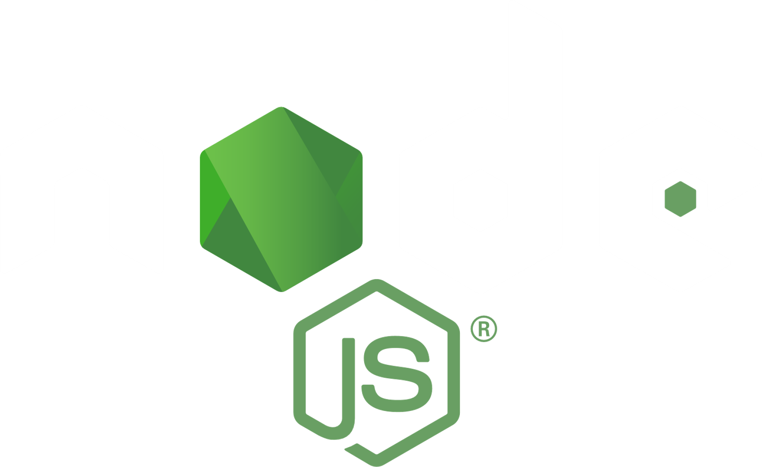
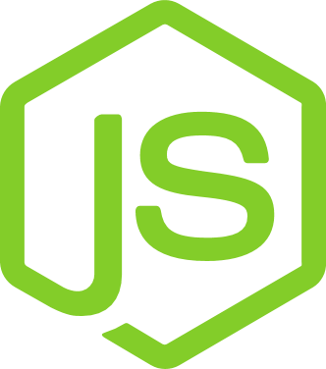
Why Should You Use
Node.js
For Web Development?

Slide 2
You may not be aware that Node.js has only been around for 12 years. In contrast to the Internet, which is 32 years old, and JavaScript, which is 24 years old, Node.js is a baby. Node.js was born at the perfect time and place, but it isn’t the sole reason for its current success. Many new concepts and approaches for server-side JavaScript development were introduced.
Source : https://www.weblineindia.com/blog/node-js-for-web-development/

Slide 3
When should we use Node.js development?
One of the most notable benefits of Node.js web development is the ability to design a wide range of business solutions. You can outperform your competitors with Node.js-based business solutions.
Source : https://www.weblineindia.com/blog/node-js-for-web-development/

Slide 4
The following are some notable applications for which Node.js can be used:
To create data streaming applications
Data streaming web apps have grown in popularity as people consume more digital material. You can process large chunks of data into smaller packages and sequentially use the Node.js web app’s built-in stream module.
For developing microservices
Node.js is favoured for creating microservices frameworks since it is simple to do so. Because it isolates the majority of the underlying or essential system, implementing a microservice with this programming language can be straightforward and efficient.
Source : https://www.weblineindia.com/blog/node-js-for-web-development/

Slide 5
The following are some notable applications for which Node.js can be used:
Suitable for Internet of Things Applications
MQTT, a publish-subscribe communications system, is widely used in Internet of Things apps. In this protocol, WebSockets are used for transport and encapsulation. MQTT and WebSockets both have extensive support and are straightforward to use with Node.js.
Development of scalable applications
It is best for creating a node app for applications that are expected to have high peak loads and scalability. For these issues, it is a good option to build a website with Node.js
Source : https://www.weblineindia.com/blog/node-js-for-web-development/

Slide 6
The following are some notable applications for which Node.js can be used:
API Communication
Almost all web applications require a back-end to interface with databases or other external services. Node.js was formerly recommended exclusively for applications with a small number of CPU-intensive tasks.
To create a SPA
Node.js, like single-page websites, may generate a single-page application (SPA) that looks and feels like a desktop program. Because of its flexibility, Node.js is an excellent choice for building social networking platforms, dynamic websites, and email systems.
Source : https://www.weblineindia.com/blog/node-js-for-web-development/

Slide 7
Avoid using Node.js for the following purposes
Process CPU-intensive and complicated applications
Node.js employs an event-based, non-blocking I/O architecture and has just one CPU - all of that intense CPU processing would prevent incoming requests from being served.
Creating server-side web applications with relational databases
You can also use Node.js and express.js to create a standard web application on the server. However, if these web applications require a lot of CPU power, Node.js’s responsiveness would suffer.
Creating a simple CRUD application
You can utilise Node.js app development, but the performance and power that Node.js is known for will be rendered ineffective.
Source : https://www.weblineindia.com/blog/node-js-for-web-development/

Slide 8
Reasons for incorporating Node.js development into your next web project
Reduced time to market
Node.js is extremely useful for reducing time-to-market. Because it is lightweight, Node.js can significantly reduce application development time while maintaining existing functionality.
Scalability
Node.js is designed for scalability. It’s one of the most essential characteristics of Node for startups aiming to grow over time. For more assistance, you may contact a Node.js app development company.
Source : https://www.weblineindia.com/blog/node-js-for-web-development/

Slide 9
Reasons for incorporating Node.js development into your next web project
Works on both the front and back end
Node.js is a universal programming language that can be used for front-end and back-end development. This fundamental capability makes a client’s life easier, as recruiting a team of skilled full-stack developers might be difficult.
A Massive Community
Many active Node.js enthusiasts and software developers from Microsoft, SAP, IBM, and others constantly contribute to the ever-evolving and nurturing Node.js community to assist other developers.
Source : https://www.weblineindia.com/blog/node-js-for-web-development/

Slide 10
Reasons for incorporating Node.js development into your next web project
Rich Ecosystem
The Node package ecosystem, which includes NPM (a node package management), is the largest and fastest-growing software registry on the planet. In the NPM ecosystem, there is a module for almost anything a software developer can think of.
Source : https://www.weblineindia.com/blog/node-js-for-web-development/

Slide 11
To Conclude
The main reason behind Node.js’s richness and simplicity is the node package manager (NPM). It includes around 1.3 million code packages. What’s more, it’s absolutely free to use. This means that developers have a large pool of packages to choose from when creating high-quality scalable applications.
Source : https://www.weblineindia.com/blog/node-js-for-web-development/

Slide 12
Some Node.js statistics
“For enterprise applications, Node.js is a popular choice among developers specially Node.js android app development. It’s using 43% of developers for enterprise applications. “
“PayPal saw a 35% drop-in average response time on their page after implementing Node.js. “
“Node.js can improve application performance by up to 50%. “
“It also cuts development expenses by 58%. “
Businesses wishing to construct scalable and resilient web apps should look for a top-rated Node.js app development company with a deep understanding of the technology.
Source : https://www.weblineindia.com/blog/node-js-for-web-development/

Slide 13
THANK YOU!
CONTACT US
EMAIL
info@weblineindia.com
+1-213-908-1090 (USA)
+61-2-8011-4668 (AUS)
+44-207-193-7507 (UK)
+91-79-26420897 (IND)
WEBSITE
www.weblineindia.com

